Slide 1
Designing Individual Supports

Slide 2
Who are you?
Who are you?
How come you are here?
What do you hope to get out of this session?
Individuals living their lives, their way.

Slide 3
Working Together
What do we need to agree to work together well?
Be Present
Misery is optional – go to the loo, get a drink
Respectful sharing of experiences
I am accountable for what I share
Everybody has a perspective
Listen to understand
Stick to times (its Friday!)
Individuals living their lives, their way.
Notes:
Move or stick

Slide 4
Why this, why now?
Individuals living their lives, their way.
Insert your Organisational context – why is it important to design individual supports?

Slide 5
At the heart of designing support
Individuals living their lives, their way.
The essence of Individual Service Design, is understanding what matters to you and then designing support accordingly.

Slide 6
Conversation Overview
Individuals living their lives, their way.
Who is the person?
What is life like now?
What a good lifestyle could look like?
My community, my place
People to share with
Understanding my support

Slide 7
Cont. Conversation Overview
Individuals living their lives, their way.
Keeping healthy and safe
Design ideas and outcomes
A typical week
Costing
Action Plan

Slide 8
Conversation Overview
Theme | Conversation
1. Who is the person? | Understanding the person, what matters to them and understanding who are significant people in their life.
2. What is life like now? | Understanding life now for the person, how life works today, the pace of life, how the person spends their time, and learning about what this tells us about what needs to stay in the person’s life and what needs to change.
3. What a good lifestyle could look like? | Developing a good understanding of what a good lifestyle could look like for the person, headlines of how life could be, who may be part of the person’s life and what they would be doing if life was going well for them
4. My community, my place | Developing a good understanding of the right community for the person and the right home. Exploring how the person can be connected to their community in ways that make sense.
5. People to share with | Exploring possibilities around sharing a home with another person and what kind of person may be the right person.
6. Understanding my Support | Exploring and understanding support including wider supports which may include unpaid support. Exploring just enough support - not too much or too little. Exploring and agreeing how the person’s decision making is respected and supported.
7. Keeping healthy and safe | Exploring ways to make sure the person stays healthy and safe including exploring ideas about how to minimise possible risks.
8. Design ideas and outcomes | Clarifying what we have learnt and what the process has helped us understand about what essentially needs to be included in the persons support design. Exploring what opportunities the design could open up for the person
9. A typical week | Creating the support for real as best we can, by planning a week and beginning to develop a clear idea of the person unique support system across a typical week.
10. Costing | Cost of the final design
11. Action Plan | Developing a clear action plan to begin to bring the design to life

Slide 9
Individuals living their lives, their way.
Facilitators Framework
No
Digging
No Obsessing
Total Respect
No
Judging
No
Fixing
Facilitators Framework
– Heather Simmons

Slide 10
Individuals living their lives, their way.
1. Who is the person?
What do you like, admire or respect about the person?
Who are they to other people? (sister, friend, aunty)
What matters to the person? (likes, dislikes, passions, interests)

Slide 11
Individuals living their lives, their way.
2. What is life like now?
Understanding life now for the person, how life works today, the pace of life, how the person spends their time.
Learning about this, tells us what needs to stay in the person’s life and what needs to change.
Good day/ bad day

Slide 12
2. Good day / bad day
Individuals living their lives, their way.
What makes a good day now ?
What makes a bad day now?
What do you notice about what’s important to the person?

Slide 13
Individuals living their lives, their way.
3. What a good lifestyle could look like?
Developing a good understanding of what a good lifestyle could look like for the person.
Headlines of how life could be.
Who may be part of the person’s life and what they would be doing, if life was going well for them?
Vision of a good life.

Slide 14
Individuals living their lives, their way.
4. My Community, my place
Developing a good understanding of the right community for the person and the right home.
Exploring how the person can be connected to their community in ways that make sense.
Where should the person be, what community resources need to be around?

Slide 15
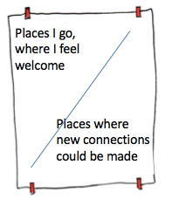
Individuals living their lives, their way.
4. My Community, my place
Community Map
– Helping our thinking

Slide 16
Individuals living their lives, their way.
5. Do I want to live with others?
Exploring possibilities around sharing a home with another person, and what kind of person may be the right person.
What kind of people work for me?
What kind of people to avoid?
People I know already?

Slide 17
Individuals living their lives, their way.
6. Understanding my Support
Exploring and understanding support, including wider supports which may include unpaid support.
Exploring just enough support - not too much or too little.
Exploring and agreeing how the person’s decision making is respected and supported.

Slide 18
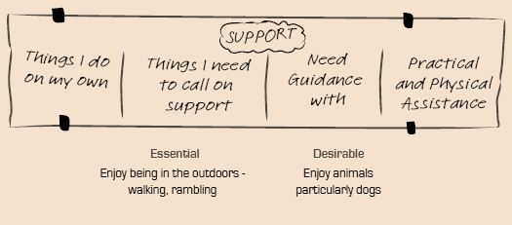
Individuals living their lives, their way.
What is good Support for me?

Slide 19
Exploring Support
Individuals living their lives, their way.
My Support
Support Options
Add specific supports
Can we support self care?
Can assistive technology help?
Family, friends or neighbors?
Community services?
Human services?
What could supporters do differently?

Slide 20
Individuals living their lives, their way.
7. Keeping healthy and safe
Exploring ways to make sure the person stays healthy and safe.
Exploring ideas about how to minimize possible risks.

Slide 21
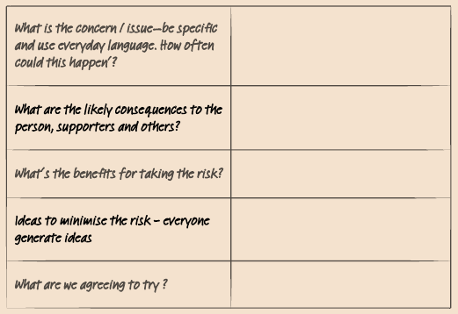
Individuals living their lives, their way.
Healthy and Safe
Anything that we need to think about that may affect how the person is supported?

Slide 22
Individuals living their lives, their way.
8. Design ideas and outcomes
Clarifying what we have learnt.
How the process has helped us understand about what essentially needs to be included in the persons support design.
Exploring what opportunities the design could open up for the person.

Slide 23
Individuals living their lives, their way.
9. A typical week
Creating the support ‘for real’ as best we can.
Planning a week.
Beginning to develop a clear idea of the person unique support system across a typical week.

Slide 24
Individuals living their lives, their way.
10. Costing the design?
Is the design within budget?
What can be changed?
Cost of the final design.

Slide 25
Individuals living their lives, their way.
11. Action Plan
How do we turn this into a reality?
Who needs to do what?

Slide 26
Reflection and Learning
Individuals living their lives, their way.
On the process
On your learning
On putting this into action

